Slide 1
The Generative AI Revolution in Market Research (GenAI–MktRes)
Transforming how firms gather data, generate insights, and understand customers.
Presented by:
Ishjot Singh Bhatia
Komal Rani

Slide 2
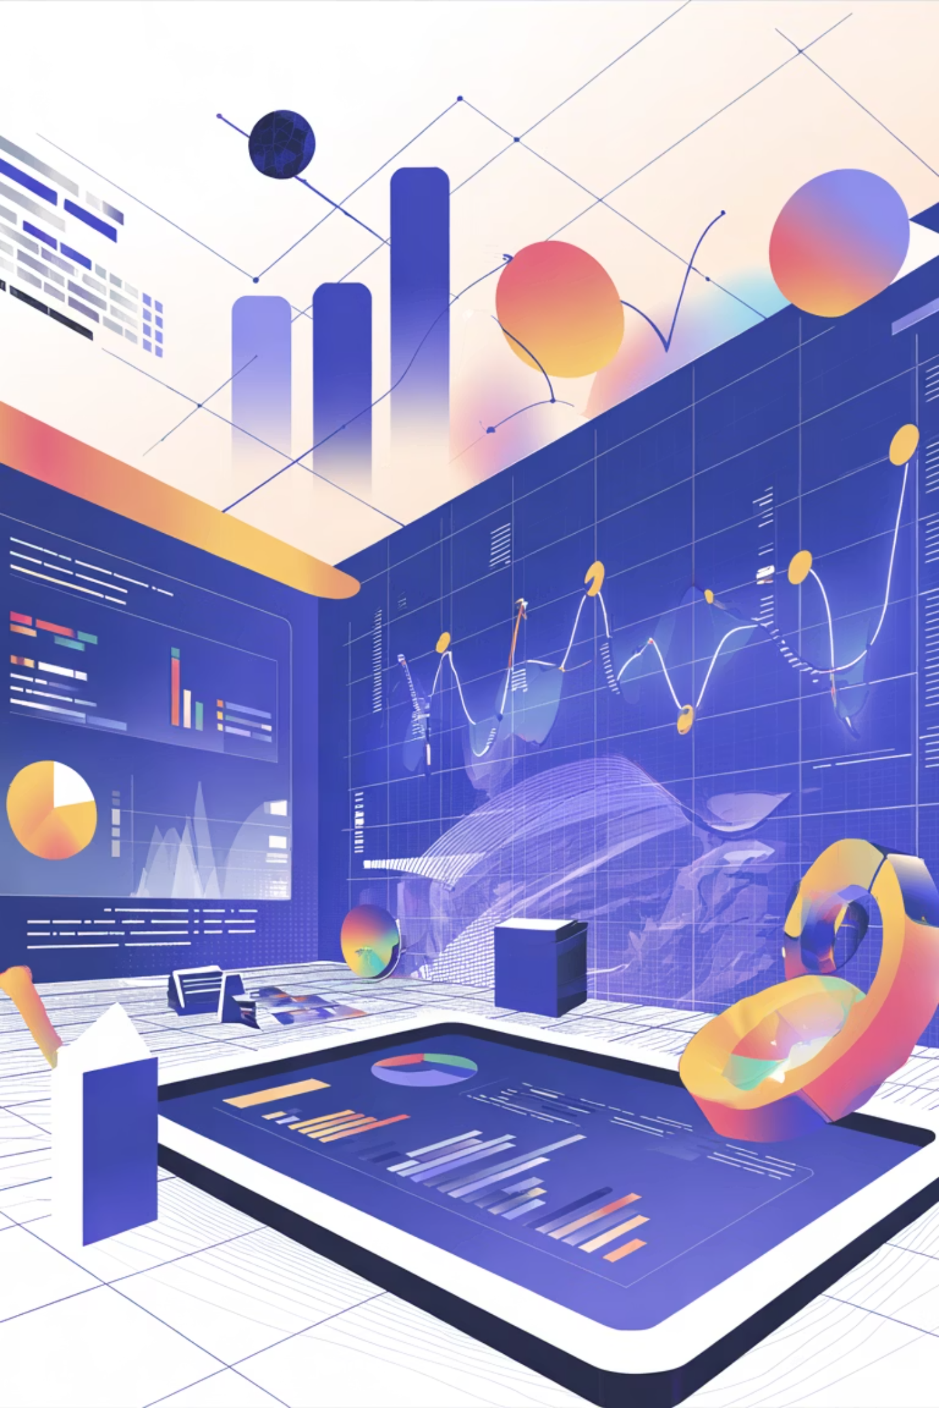
Generative AI ?
AI that can create text, images, or data like humans.
Tools like ChatGPT and others help analyze large data quickly.
It is now used widely in marketing and research.

Slide 3
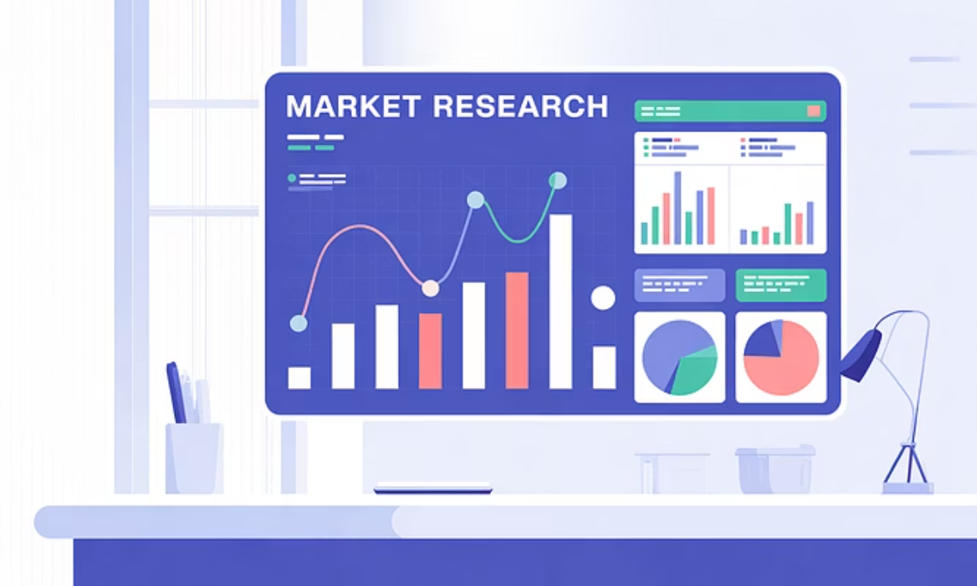
Why Market research needs GenAI
Traditional research methods are slow, costly, and time-consuming.
Companies need faster, smarter, and more creative ways to understand customers.
Generative AI makes this possible by automating surveys, analysis, and reporting.
This case shows how AI is transforming research efficiency and accuracy.

Slide 4
Four Main Opportunities with GenAI
Supporting current practices – making research faster and easier.
Replacing current practices – using synthetic data instead of real surveys.
Filling existing gaps – providing insights where data is missing.
Creating new kinds of data and insights – using digital twins for simulation.

Slide 5
How Gen AI Can Enhance Current Market Research Practices
Research Stage | Synthesis | Coding | Interaction | Writing
Opportunity Identification & Research Design | Summarizing existing research and literature | Mining existing data for hypotheses | Using chatbots for brainstorming and idea generation | Generating hypotheses
Data Collection & Analysis | Extracting meaning and insights from text | Setting up surveys in a web interface; performing analytics | Using synthetic interviewers to ask follow-up questions | Creating study materials
Reporting & Dissemination | Articulating takeaways | Creating data visualization tools | Using chatbots for data exploration | Crafting executive summaries

Slide 6
Real World Examples
Company | AI Use Case | Purpose | Key Takeaway
Outset.ai | AI Interviewer | Uses AI to conduct qualitative interviews, dynamically asks follow-up questions based on participants’ responses. | Provides deeper, more natural insights; reduces interviewer bias. Weight Watchers found participants more open with AI than humans.
Meaningful.app | AI Survey & Analysis Platform | Automates survey creation, distribution, and analysis using Gen AI. | Speeds up research, combines qualitative interviews and quantitative surveys for better insights.

Slide 7
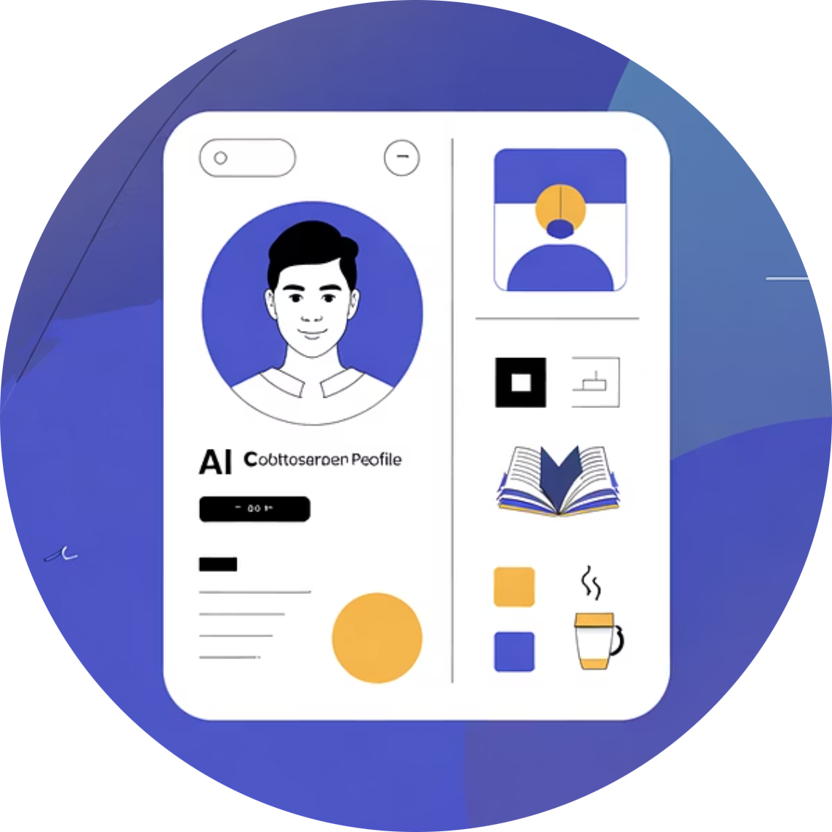
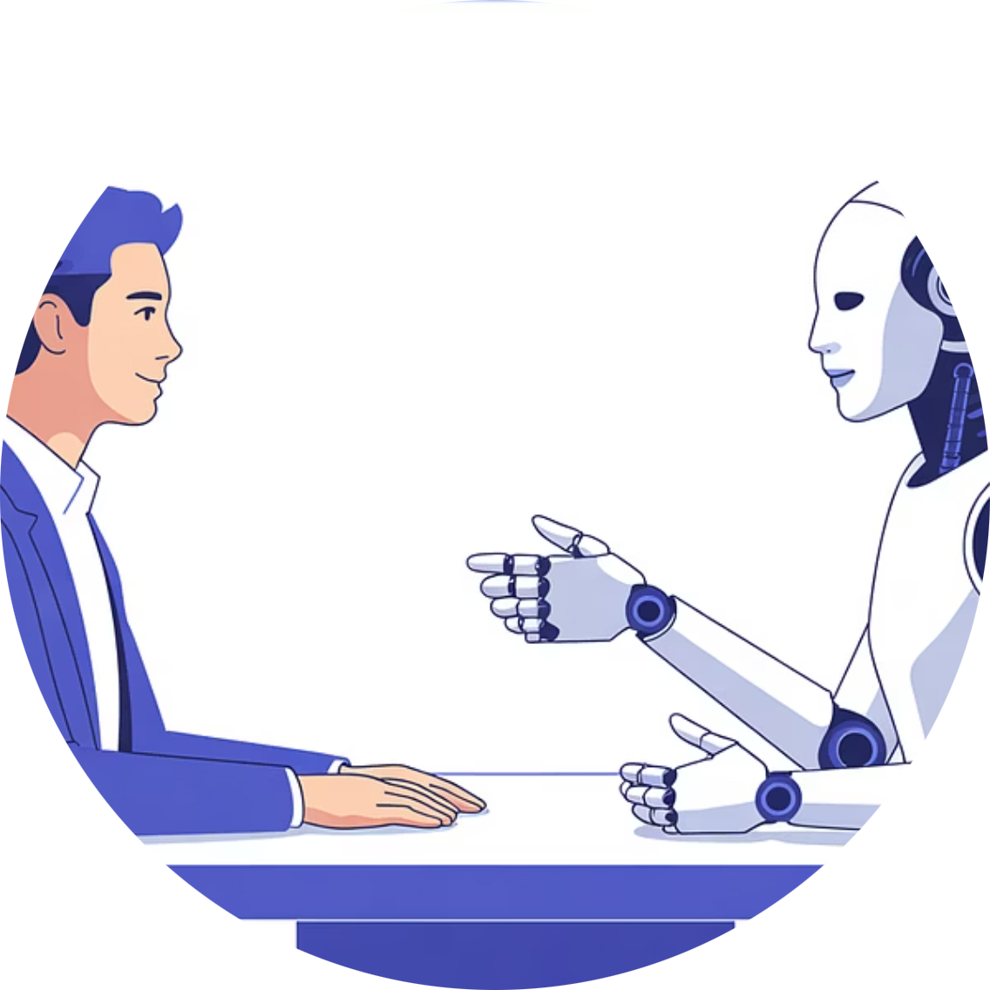
Replacing Current Practices
Synthetic Data: AI-generated data that acts like real responses.
81% of firms already use or plan to use synthetic data. It helps simulate customer behavior quickly.

Slide 8
Real World Examples
Replacing Traditional Methods with Synthetic Data
Company / Platform | AI Use Case | Purpose / Application | Key Takeaway (Result or Value)
Evidenza + EY | Synthetic Data Validation | Created 1,000+ synthetic personas to replicate CEO survey responses for EY. | Achieved 95% accuracy compared with real survey results — showing high reliability of synthetic data.
Synthetic Users (Portugal) | Synthetic Qualitative Interviews | Conducts in-depth interviews with AI-generated (synthetic) respondents to mimic human insights. | Enables rich qualitative research without live participants, reducing cost and time.
Rockfish Data | Private Custom AI Models | Builds company-specific Gen AI models on proprietary data for full privacy. Clients include U.S. Army and Homeland Security. | Ensures data confidentiality while replacing third-party AI tools.

Slide 9
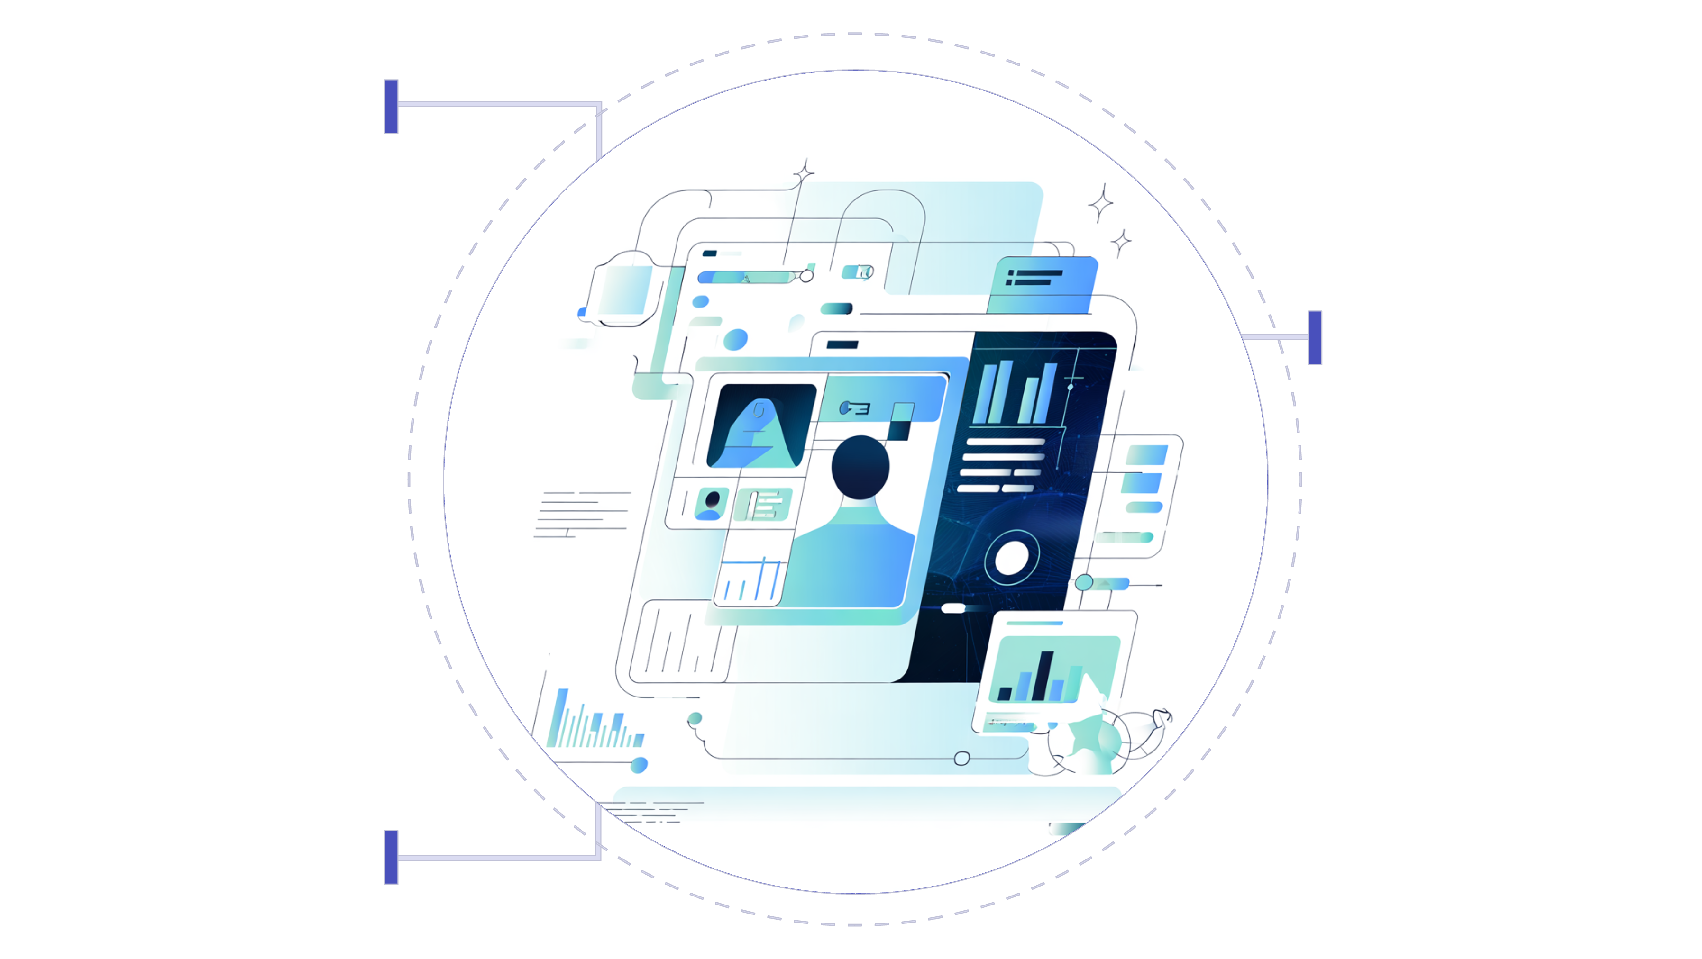
Creating New Data & Insights
Virtual Sales Training Simulate realistic buyer interactions.
Behavioral Simulation Model and predict customer actions.
Personalized Campaign Testing Pre-test messages on replicas.

Slide 10
Creating New Data Types (Digital Twins & AI Simulations)
Company / Platform | AI Use Case | Purpose / Application | Key Takeaway (Result or Value) | Category of Use
Ogilvy | Campaign Pretesting on Digital Twins | Tests marketing campaigns on digital twins (virtual consumers) before launch. | Helps ensure campaign messages resonate and minimizes real-world risk. | Creating New Data Types
CivicSync | Customer Behavior Digital Twins | Tracks consented online behaviors to build precise digital twins of target users. | Enables realistic simulation of consumer behavior and testing of offers. | Creating New Data Types
Columbia Business School + Google DeepMind | Academic Digital Twin Research | Built 2,500 digital twins mirroring real humans for survey and behavior simulation. | Found 85% accuracy between AI twins and real people’s responses — showing strong predictive potential. | Creating New Data Types

Slide 11
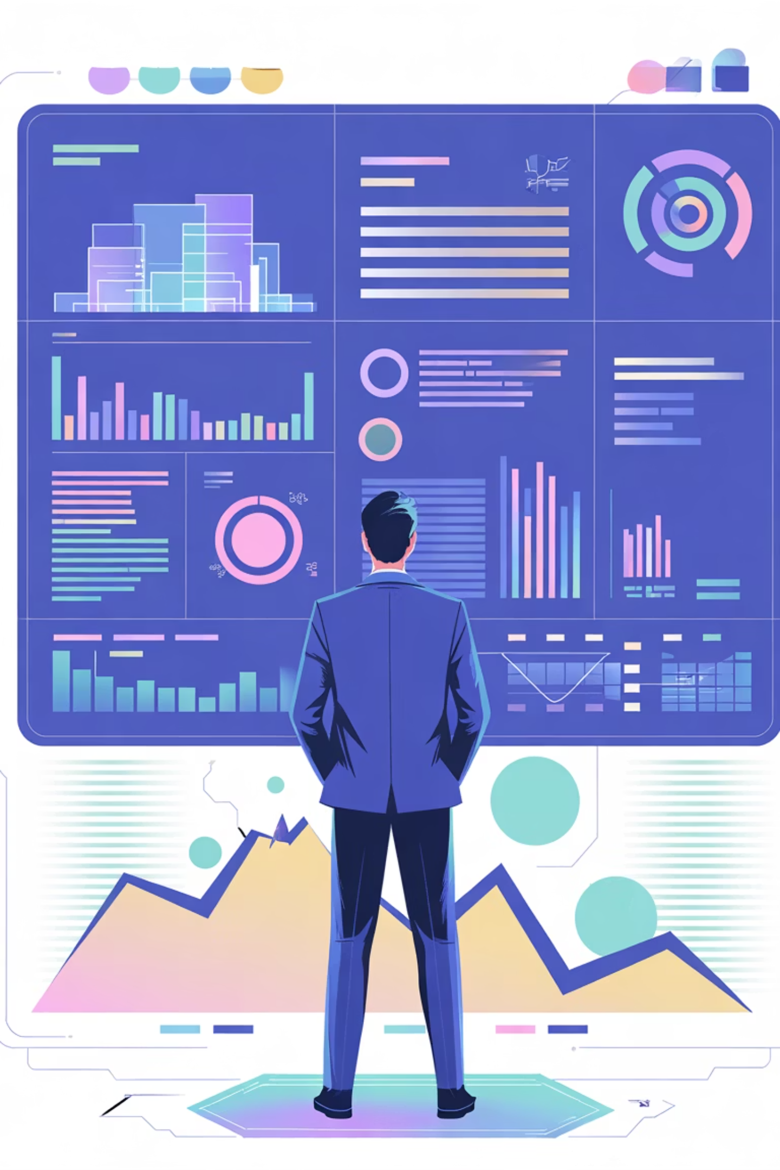
Filling Existing Gaps
Many decisions are made without full data due to time/cost limits.
GenAI helps fill these gaps by generating quick insights and predictions.

Slide 12
Examples Filling Existing Gaps (Faster Insights Where Real Data Is Costly or Slow)
Company / Platform | AI Use Case | Purpose / Application | Key Takeaway (Result or Value) | Category of Use
General Mills | Product Ideation Accelerator | Uses synthetic data to simulate consumer preferences and test new product ideas. | Speeds up product design and increases chance of discovering strong market-fit ideas. | Filling Existing Research Gaps
Arena Technologies | Retail Analytics Optimization | Applies Gen AI and synthetic data to understand local customer profiles and help retailers make store-level decisions. | Improves targeting, messaging, and ROI through predictive synthetic modeling. | Filling Existing Research Gaps

Slide 13
Some more examples…
Company / Platform | AI Use Case | Purpose / Application | Key Takeaway (Result / Value) | Category of Use
Tata Consumer Products | Sentiment & Review Analysis | Analyze customer reviews & social media to understand product perception | Faster insights → Better decisions → Quicker product launches | Supporting Current Practices
Flipkart & Amazon India | Synthetic Buyer Personas | Simulate buyer trends (festive demand) using synthetic data | Saves survey cost & time, scalable trend prediction | Replacing Traditional Research
HDFC Bank & ICICI Bank | AI-Generated Testing Data | Test customer response to digital features before launch | Lower cost & risk, improved customer targeting | Replacing Traditional Research
Aditya Birla Fashion (ABFRL) | Virtual Design Testing | Predict which apparel styles/colors appeal to youth | Data-driven fashion forecasting | Replacing Traditional Research
Nykaa | Regional Behavior Analysis | Study preferences in humid vs. dry regions | Continuous, location-based insights | Filling Research Gaps
Reliance Retail & Tata Neu | Digital Twin of Shoppers | Build virtual consumer models for offers, layouts, rewards | Personalized marketing → Higher ROI | Creating New Data Types

Slide 14
Understanding the Limitations
Bias in AI-generated data.
Less variation in responses vs. humans.
Not stable over time.
Difficult to predict emotions or sensory reactions.

Slide 15
Ethical & Practical Issues
Companies worry about privacy and data sharing.
AI models must avoid misuse of sensitive data.
Researchers should randomize prompts to avoid bias in answers.

Slide 16
Recommendations & Key Takeaways
Recommendations
Use AI to support humans, not replace them
Validate AI-generated data with real-world data
Keep data private and secure through enterprise models
Review results carefully to detect bias or hallucinations
Key Takeaways
GenAI makes research faster, more creative, and more efficient
AI helps with data synthesis, analysis, and ideation
But it brings bias, privacy, and accuracy challenges
Human validation remains essential for trustworthy results
The best outcomes come from Humans + AI working together

Slide 17
Discussion Questions
Does using Generative AI in market research give a company a competitive advantage, or will it soon become a basic requirement for everyone in the industry?
If AI handles most of the research process, how should humans and AI work together to produce trustworthy and creative insights?

